Slide 1
Measuring Internal Product Attributes
Structure

Slide 2
Structure
The structure of requirements, design, and code can help us to understand the difficulty
We would like to assume that a large module takes longer to specify, design, code, and test than a small one. But experience shows us that such an assumption is not valid; the structure of the product plays a part.
We can think of structure from at least two perspectives:
Control ﬂow structure: Sequence of execution of instructions of the program. This aspect of structure reﬂects the iterative and looping nature of programs.
Data ﬂow structure: Keeping track of data as it is created or handled by the program. Data ﬂow measures depict the behavior of the data as it interacts with the program.

Slide 3
Structural Complexity
Complexity captures the complicatedness of the connections between elements in a system model.
Structural Complexity Properties
Nonnegativity: System complexity cannot be negative.
Null value: The complexity of a system with no links is zero
Symmetry: The complexity of a system does not depend on how links are represented.
Module monotonicity: System complexity “is no less than the sum of the complexities of any two of its modules with no relationships in common.”
Disjoint module additivity: The complexity of a system of disjoint modules is the sum of the complexities of the modules.

Slide 4
Goal & Questions …
Q1: How to represent “structure” of a program?
A1: Control-flow diagram
Q2: How to define “complexity” in terms of the structure?
A2: Cyclomatic complexity; depth of nesting

Slide 5
Basic Control Structures (BCS)
Basic Control Structures (BCSs) are set of essential control-flow mechanisms used for building the logical structure of the program.
BCS types:
Sequence: e.g., a list of instructions with no other BCSs involved.
Selection: e.g., if … then … else.
Iteration: e.g., do … while ; for … to … do.
Advanced BCSs), such as:
Procedure/function/agent call
Recursion (self-call)
Interrupt
Concurrence

Slide 6









CFG
 | Sequence
 | Selection
 | Iteration
 | Procedure/ function call
 | Recursion
 | Interrupt |  | Concurrence

Slide 7
Control Flow Graph (CFG)
Control flow structure is usually modeled by a directed graph (di-graph)
CFG = {N, A}
Each node n in the set of nodes (N) corresponds to a program statement.
Each directed arc (or directed edge) a in the set of arcs (A) indicates flow of control from one statement of program to another.
Procedure nodes: nodes with out-degree 1.
Predicate nodes: nodes with out-degree other than 1 and 0.
Start node: nodes with in-degree 0.
Terminal (end) node: nodes with out-degree 0.

Slide 8





Flowgraph
Definition [FeR97]: A flowgraph is a directed graph in which two nodes, the start node and the stop node, obey special properties: the stop node has out-degree zero, and the start node has in-degree zero. Every node lies on some path from the start node to the stop node.

Slide 9
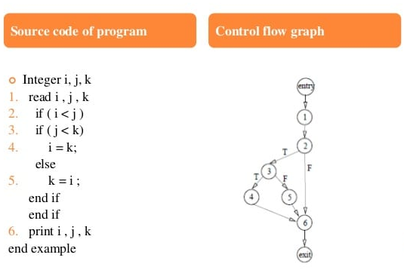
Control Flow Graph (CFG)

Slide 10
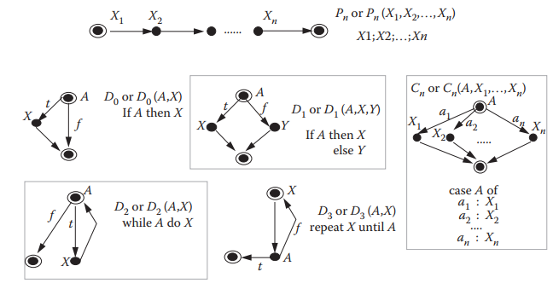
Basic Control Structures (BCS)

Slide 11
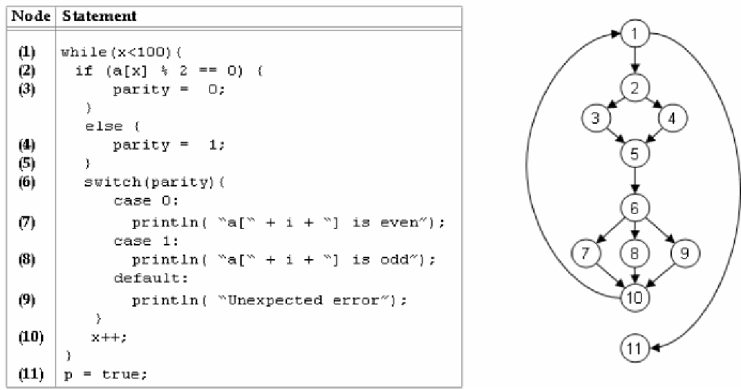
Control Flow Graph (CFG)

Slide 12
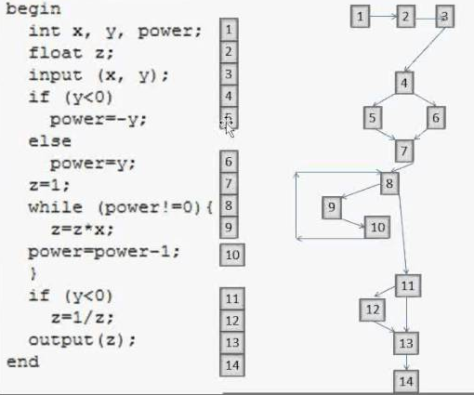
Control Flow Graph (CFG)

Slide 13
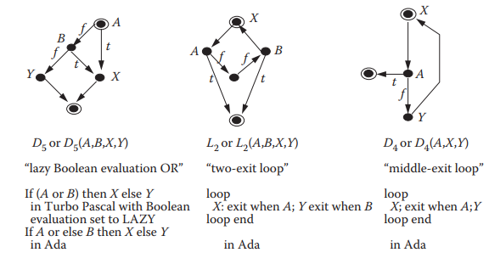
less common control constructs
Y

Slide 14
Prime flow graphs
Prime flow graphs are flow graphs that cannot be decomposed non-trivially by sequencing and nesting.
Examples:
P_{n} (sequence of n statements)
D₀ (if-condition)
D₁ (if-then-else-branching)
D₂ (while-loop)
D₃ (repeat-loop)
C_{n} (case)

Slide 15
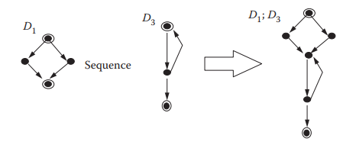

Sequencing
Let F1 and F2 be two flowgraphs. Then, the sequence of F1 and F2, (shown by F1; F2) is a flowgraph formed by merging the terminal node of F1 with the start node of F2.

Slide 16
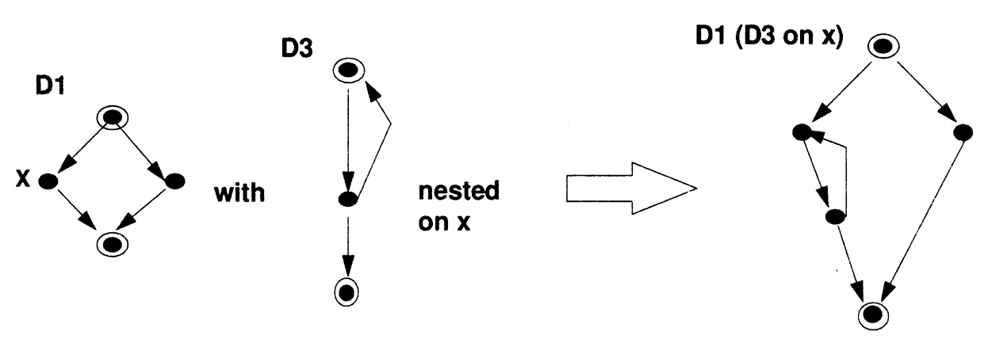

Nesting
Let F1 and F2 be two flowgraphs. Then, the nesting of F2 onto F1 at x, shown by F1(F2) is a flowgraph formed from F1 by replacing the arc from x with the whole of F2.

Slide 17
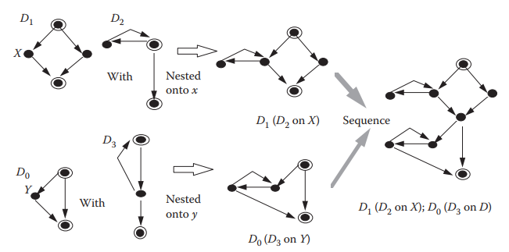
Combining the sequence and nesting operations
we may wish to nest n ﬂowgraphs F1, …, Fn onto n respective procedure nodes x1, …, x2.
The resulting ﬂowgraph is written as F(F1 on x1, F2 on x2, …, Fn on xn.) or F(F1, F2, …, Fn).

Slide 18
S-structured Graph
The common definitions of structured programming assert that a program is structured if it can be composed using only a small number of allowable constructs. Normally, these constructs must be only sequence, selection, and iteration.
A family S of prime flowgraphs is called S-structured graph (or S-graph) if it satisfies the following recursive rules:
Each member of S is S-structured.
If F and F′ are S-structured ﬂowgraphs, then so are
F;F′
F(F′) (whenever nesting of F′ onto F is defned)
No ﬂowgraph is an S-structured graph unless it can be shown to be generated by a finite number of applications of the above steps.

Slide 19
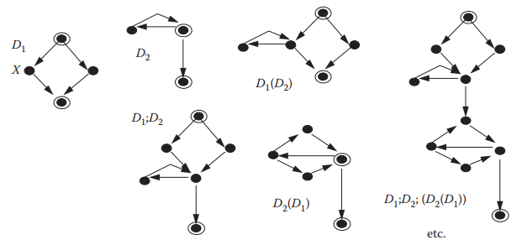
Examples of S-structured graphs when S = {D1, D2}

Slide 20
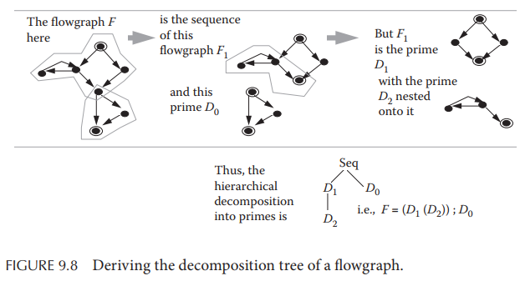
Prime Decomposition
Any flow graph can be uniquely decomposed into a hierarchy of sequencing and nesting primes, called “decomposition tree”. (Fenton and Whitty, 1991)

